Slide 1


Please download and install the Slido app on all computers you use
Join at slido.com
#123-2024
ⓘ Start presenting to display the joining instructions on this slide.
Notes:
If using “Slido”, be sure to download app well in advance and do a trial run
Be sure to connect with the teacher to ensure their support of using devices

Slide 2
Local Government Week
October 2024
Add Logo
Notes:
Add school board logo to this slide
Say hello and introduce yourself
This week, the INSERT YOUR SCHOOL BOARD HERE, along with our partners at the Ontario Public School Boards’ Association (OPSBA), is working to raise civic awareness among our students by observing Local Government Week.
School board trustees are the oldest form of elected representation in Ontario. Since 1807, generations of community-minded citizens have made decisions on behalf of local, publicly funded schools, building the foundation of our system today.

Slide 3
Levels of government in Canada
FEDERAL
PROVINCIAL or TERRITORIAL
MUNICIPAL and SCHOOL BOARD
Notes:
Remind students that there are 3 levels of government – some students may have already learned this
Check with the teacher to see what the students have covered off in the curriculum and what is still planned
Consider adding what some current issue your municipal counterparts are discussing/dealing with compared to issues you and your board are discussing. (i.e. utilities, services such as leaf pick up or snow removal, transit)

Slide 4

Who is in our Municipal Government?
Municipal Elections occur every four years in Ontario
The leader of the local/regional municipal government can be called the Mayor / Reeve / Regional Chair / Warden
Our municipality elects X# Councillors who form City/Town/County/Regional Council
The local (name of region/ward) elects X# Public School Board Trustee
Notes:
Please note: You can move the yellow pin marker around the province by clicking and dragging it to show your location.
Update this slide information to reflect your local landscape and the correct terminology
For more information: https://www.amo.on.ca/about-us/municipal-101/how-local-government-works

Slide 5
Trustees...
  School board trustees are the oldest form of elected representation in Ontario.
  The office has been in existence since 1807 and represents citizens in the education decision-making process.
  The election of school board trustees is governed by the Education Act and the Municipal Elections Act, 1996. Both are the laws or rules that trustees follow.
Notes:
School board trustees are members of a district school board. They are locally-elected representatives of the public, and they are the community’s advocates for public education.
School board trustees are the oldest form of elected representation in Ontario. Since 1807, generations of community-minded citizens have made decisions on behalf of local, publicly funded schools, building the foundation of the system we have today.
The election of school board trustees is governed by the Education Act and the Municipal Elections Act, 1996. Both are the laws or rules that trustees follow.
Additional information about Ontario’s Public Education System:
Preparing students to become productive and contributing citizens is the foundation of a civil society.
Ontario’s English public district school boards provide universally accessible education for all students, regardless of their ethnic, racial, or cultural backgrounds; social or economic status; gender; individual exceptionality; or religious preference.
The English public system is founded on the principle of equity of educational opportunity: every student deserves an opportunity to achieve to his or her fullest potential.
Public school boards provide high standards in their programs and ensure that there are supports and resources to help all students reach those standards.
Public school boards also focus on character education to ensure that students develop as caring and responsible members of their community and of Canadian society as a whole.
Character education embraces values such as Citizenship, Cooperation, Courage, Empathy, Fairness, Honesty, Humility, Inclusiveness, Initiative, Integrity, Kindness, Optimism, Perseverance, Resilience, Respect, and Responsibility.
English public district school boards, in partnership with parents and caregivers, prepare students for success in whatever field they choose.

Slide 6
Who am I?
SCHOOL BOARD LOGO HERE
  3-5 biographical notes here
INSERT HEADSHOT PHOTO HERE
Notes:
Insert biographical notes and images
Provide information that tells the students about yourself outside of being a trustee – consider including relatable things like family, pets, favourite foods, TV shows, hobbies etc.
Include contact information

Slide 7
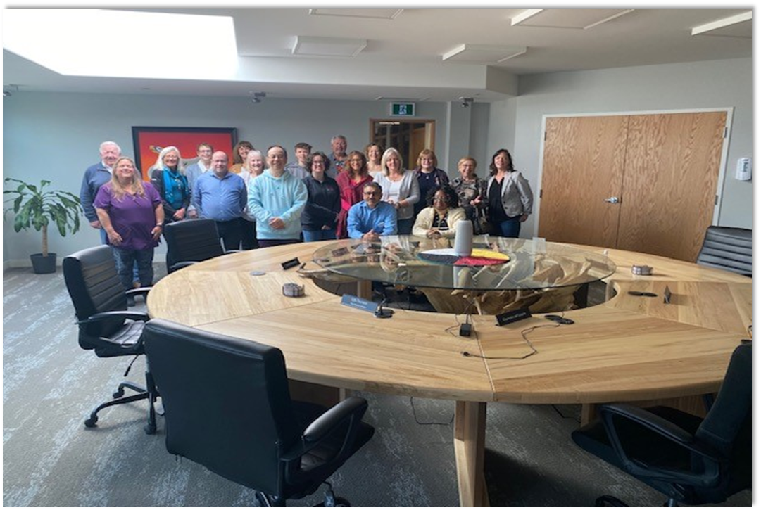
Who are the people in a school board?
Parents & Caregivers
Students (YOU!)
Trustees
Central Staff
Teachers
Director of Education
Education Workers
Supervisory Officers
(Superintendents)
Principals & Vice-Principals
Notes:
Trustees play a key leadership role in ensuring that schools operate within the standards established by the province, and that the programs and services remain responsive to the communities they serve.
The Director of Education is the chief executive officer and chief education officer of the school board. The director is the sole employee who reports directly to the board and acts as secretary of the board.
Supervisory Officers, often called superintendents, are accountable to the director of education for the implementation, operation, and supervision of educational programs in their schools.
Principals are the educational leaders within their school communities and ensure that the programs that are in place are effective and align with board and ministry policies.
Teachers are the front-line representatives of the education system. Their many activities go beyond instruction and include encouraging students to pursue learning, maintaining classroom discipline, and evaluating students’ learning and progress.
Education Workers include a whole range of people that support students and keep a safe and healthy school environment. Educational Assistants, Early Childhood Educators, Caretakers, School Secretaries, Social Workers, and Speech and Language Pathologists are just some of these.
Parents/Caregivers are critical in the support they provide in the overall education of our students.
Students are the most important stakeholders in our system.

Slide 8

What’s the name of your school board?
Notes:
Slido Slide 1

Slide 9

So, what do trustees do?
We’re here to support you.
Notes:
This is an overview that you can refer to:
Attend and participate in meetings of the board, including meetings of board committees
Consult with parents, students and supporters of the board on the board’s multi-year plan
Bring concerns of parents, students and supporters of the board to the attention of the board
Uphold the implementation of any board resolution after it is passed by the board
Entrust the day–to-day management of the board to its staff through the board’s director of education
Maintain focus on student achievement and well-being
Comply with the board’s code of conduct.

Slide 10

What is the role of a trustee?
Notes:
Slido Slide 2

Slide 11
What do I do? (Ward & Board)
Ward (Local Area)
  Add three local responsibilities
  Board (whole Board)
  Add two to three board-wide responsibilities
Notes:
Add some important topics/issues that affect your local ward, even specific schools
Add board-wide issues, could include current policies out for consideration etc.

Slide 12
FAQ 1:
What does my day look like?
Notes:
Have fun with this… try to paint a picture of a typical day that involves your trustee work.

Slide 13
FAQ 2:
How do I differ from the educators who work in schools?
Notes:
Remind students of your role as a trustee and member of the school board

Slide 14
FAQ 3:
What can I do for you?
Notes:
Remind students that one of your responsibilities is to listen and “Bring concerns of parents, students and supporters of the board to the attention of the board”
Include how you currently reach out to your community

Slide 15
FAQ 4:
Why are trustees important?
Notes:
School board trustees establish the board vision, develop policies, advocate resources, and set the goals that lay the foundation driving programs and operations in the board.

Slide 16
How many types of trustees are there?
Notes:
Slido Slide 3

Slide 17
There are 4 types of trustees
Trustees elected every four years during municipal and school board elections.
Indigenous Trustees appointed to the board by their First Nation. More than half of Ontario’s English public school boards have Indigenous Trustees.
Student Trustees elected by the student body of the board.
Hospital board/school authority trustees, appointed by the Minister of Education for a term of four years.
Notes:
There are four different kinds of trustees:
Trustees elected every four years during municipal and school board elections, including more than 320 publicly elected trustees representing 31 public English school boards and three school authorities across Ontario.
Indigenous Trustees appointed to the board by their First Nation. More than half of Ontario’s English public English school boards have Indigenous Trustees.
Student Trustees elected by the student body of the board. The Ontario Student Trustees' Association (OSTA-AECO) represents more than two million students. Many boards also have Indigenous Student Trustees representing the concerns and needs of Indigenous students.
Hospital board/school authority trustees are appointed by the Minister of Education for a term of four years, on the same term cycle as publicly elected trustees.

Slide 18

Student achievement and well-being.
Ensuring effective stewardship of the board’s resources.
Delivering effective and appropriate education programs for their students.
Notes:
School boards – the elected board of trustees – are responsible for student achievement and well-being, for ensuring effective stewardship of the board’s resources and for delivering effective and appropriate education programs for their students.
The Education Act and its regulations set out the services that district school boards and school authorities must offer. The responsibilities of a school board include a key governance role with respect to:
operating schools according to provincial legislation
having a vision statement that reflects the board’s philosophy and local needs and priorities
setting the board’s budget within the provincial grants and accompanying regulations
implementing curriculum according to ministry curriculum policy
developing and delivering other programs that reflect provincial policies and local priorities
providing for the hiring of teachers and other staff required in their schools
maintaining school buildings and property regarding student safety and in accordance with provincial legislation
monitoring the policies of the schools and the achievement of students and, through the director of education, holding the entire system accountable for meeting provincial and board standards.

Slide 19
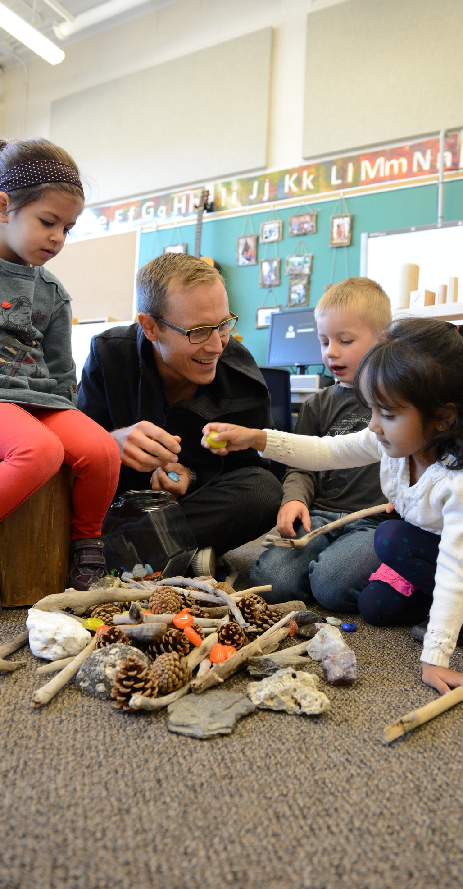


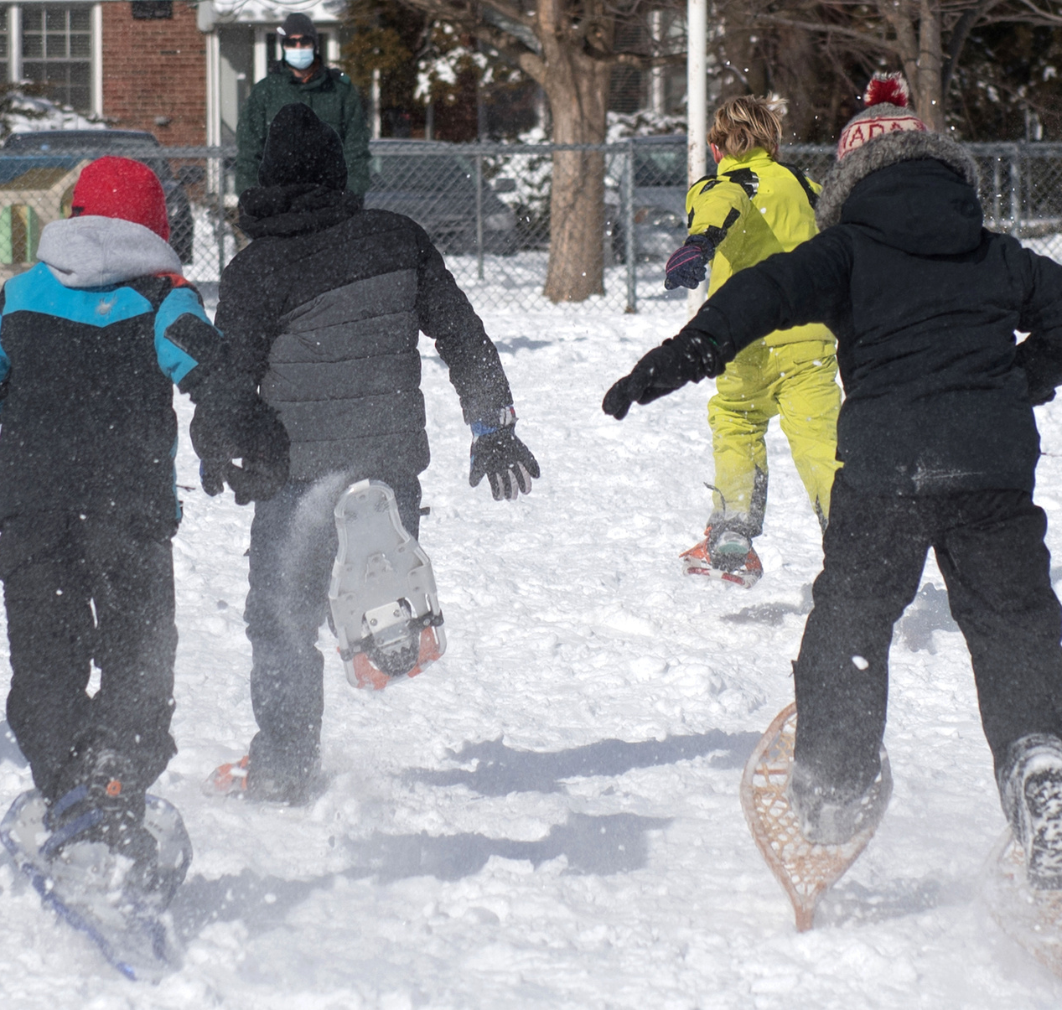
What do you think are some issues related to education?
Notes:
Discussion Slide 1

Slide 20
Are any of these education-related issues important to you?
Capital
Special Education
Child-care
Indigenous Education
Children and Youth Mental Health
Student Achievement
Equity, Diversity, and Inclusion
Well-being
Facilities
Transportation
Healthy Schools
Technology
Notes:
Discussion Slide 2

Slide 21
Let’s discuss!
What would you like trustees to know about these education-related issues in your classrooms?
Capital
Special Education
Child-care
Indigenous Education
Children and Youth Mental Health
Student Achievement
Equity, Diversity, and Inclusion
Well-being
Facilities
Transportation
Healthy Schools
Technology
Notes:
Discussion Slide 3

Slide 22

Audience Q&A
Notes:
Be sure to capture the main questions you are asked and keep a record of anything that you need to follow up on
Re-share your contact information

Slide 23
Thank You
About OPSBA
Our board is a member of the Ontario Public School Boards’ Association (OPSBA), which represents 31 English public district school boards and 10 public school authorities across Ontario.
OPSBA’s members serve the educational needs of nearly 1.4 million elementary and secondary students. The Association, based in Toronto, advocates to the provincial government on behalf of the best interests and needs of the public school system in Ontario.
Notes:
More information at www.opsba.org

